Slide 1
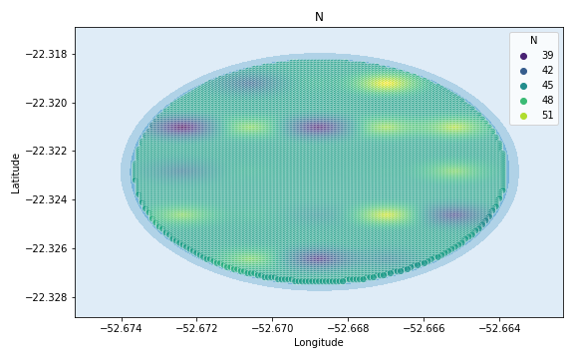
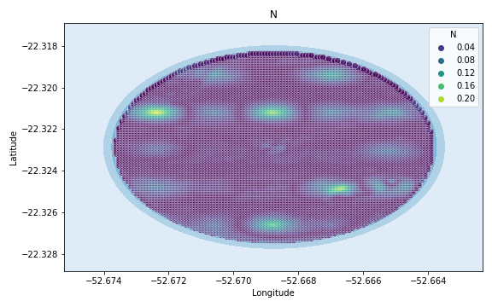
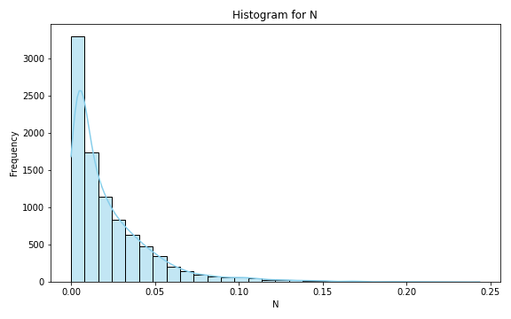
Analysis for column: N Model: Random Forest
Statistics:
mean 4.682413e+02
std 2.090315e+03
min 1.232297e-15
25% 2.381856e-02
50% 4.093784e-02
75% 2.816125e-01
80% 4.825459e-01
85% 1.510041e+00
90% 3.565741e+00
95% 4.775724e+02
99% 7.574714e+03

Slide 2
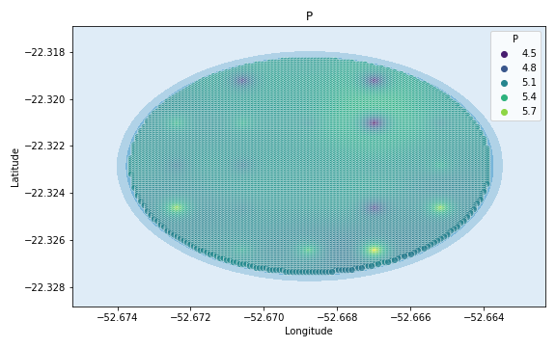
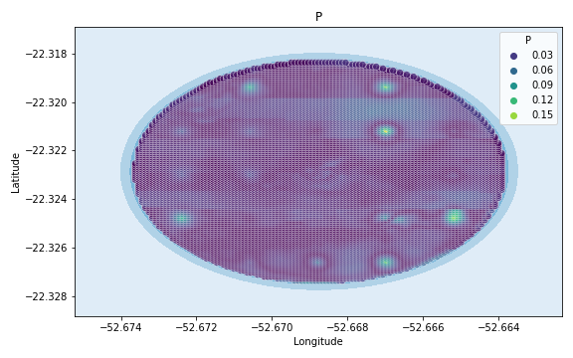
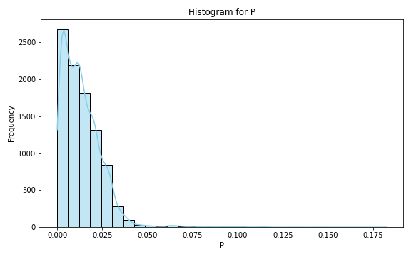
Analysis for column: P Model: Random Forest
Statistics:
mean 468.681213
std 2090.214881
min 0.000001
25% 0.012075
50% 0.020212
75% 0.194640
80% 0.354768
85% 1.307467
90% 4.760814
95% 486.373188
99% 7576.474638

Slide 3
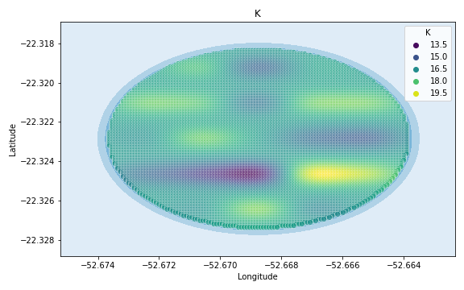
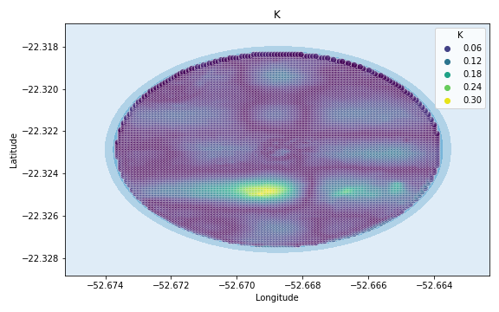
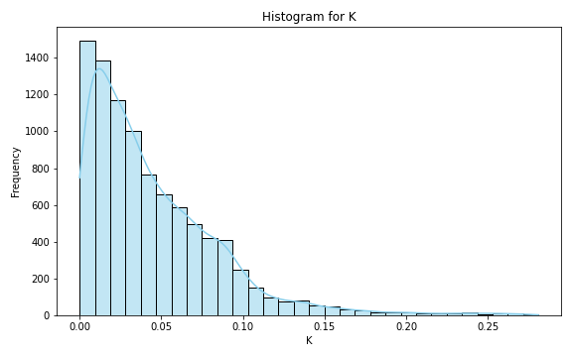
Analysis for column: K Model: Random Forest
Statistics:
mean 468.157650
std 2090.334410
min 0.000002
25% 0.041890
50% 0.070174
75% 0.325660
80% 0.459668
85% 1.214316
90% 3.126334
95% 476.175701
99% 7574.435140

Slide 4
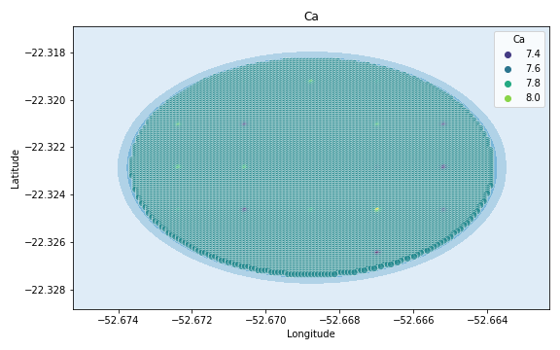
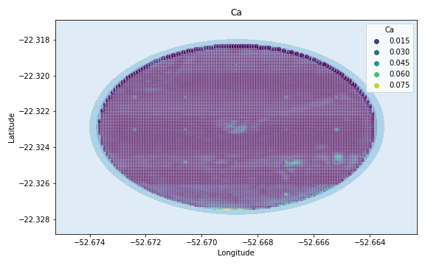
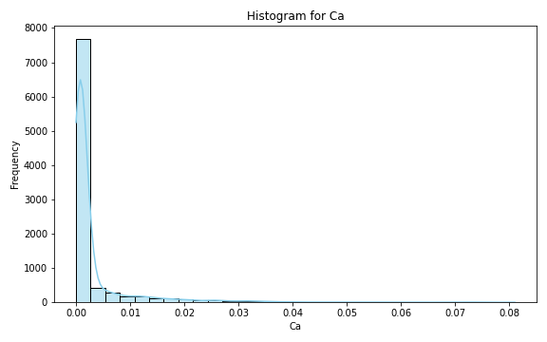
Analysis for column: Ca Model: Random Forest
Statistics:
mean 4.971795e+02
std 2.087306e+03
min 3.776552e-13
25% 6.646585e-05
50% 2.633663e-04
75% 6.011421e-02
80% 1.637988e+00
85% 9.947476e+00
90% 7.566680e+01
95% 1.004431e+03
99% 7.680086e+03

Slide 5
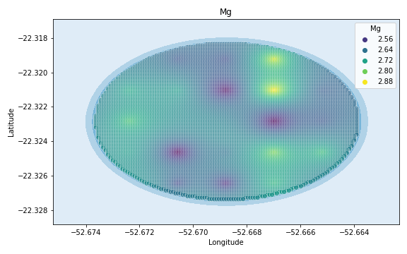
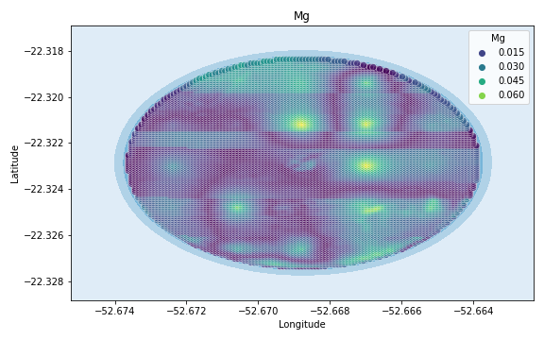
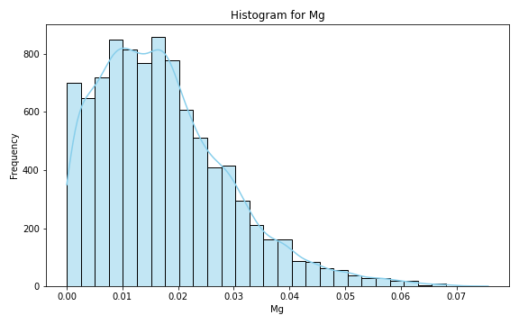
Analysis for column: Mg Model: Random Forest
Statistics:
mean 4.677659e+02
std 2.090426e+03
min 4.430545e-08
25% 1.313930e-02
50% 2.233610e-02
75% 8.236014e-02
80% 2.352704e-01
85% 9.546163e-01
90% 1.756992e+00
95% 4.707612e+02
99% 7.573352e+03

Slide 6
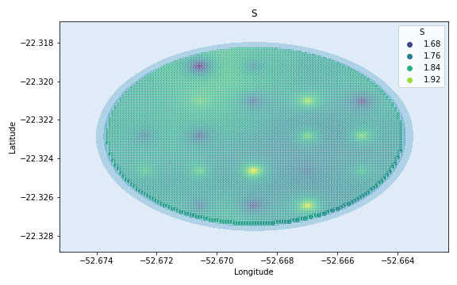
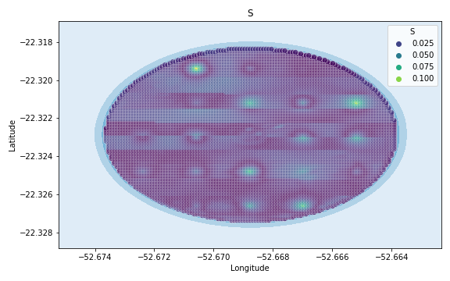
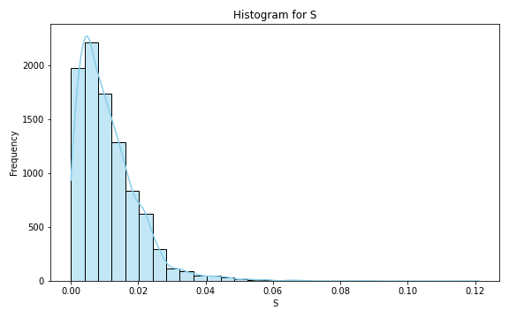
Analysis for column: S Model: Random Forest
Statistics:
mean 4.682116e+02
std 2.090322e+03
min 4.287756e-07
25% 9.729687e-03
50% 1.656462e-02
75% 1.186099e-01
80% 2.888087e-01
85% 1.196915e+00
90% 3.370444e+00
95% 4.782223e+02
99% 7.574844e+03

Slide 7
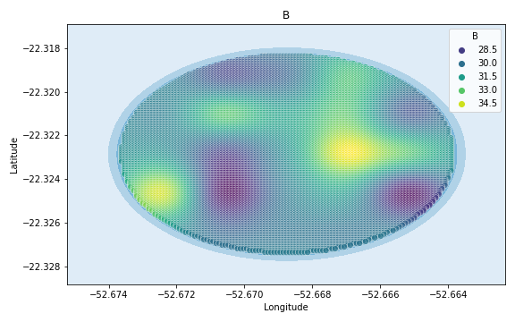
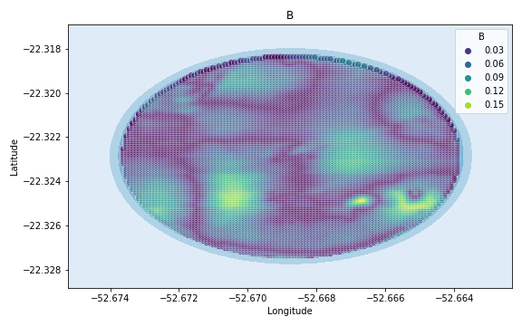
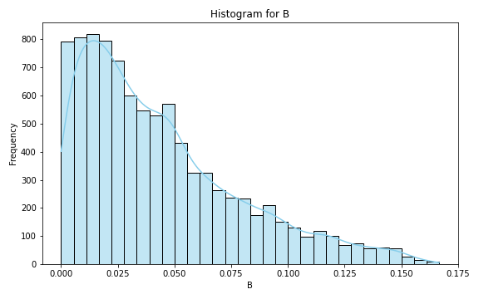
Analysis for column: B Model: Random Forest
Statistics:
mean 467.641918
std 2090.454803
min 0.000007
25% 0.038585
50% 0.066728
75% 0.183127
80% 0.303679
85% 0.802635
90% 0.913334
95% 468.451660
99% 7572.890332

Slide 8
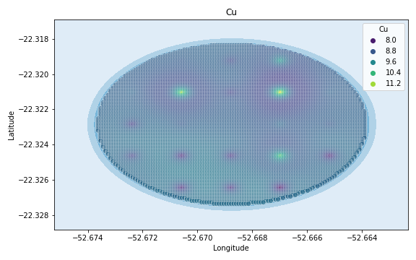
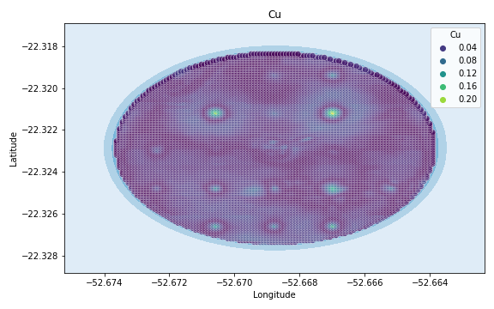
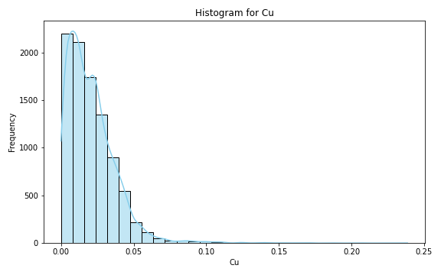
Analysis for column: Cu Model: Random Forest
Statistics:
mean 468.660597
std 2090.219501
min 0.000001
25% 0.017754
50% 0.030754
75% 0.254051
80% 0.392182
85% 1.247848
90% 4.613206
95% 485.918958
99% 7576.383792

Slide 9
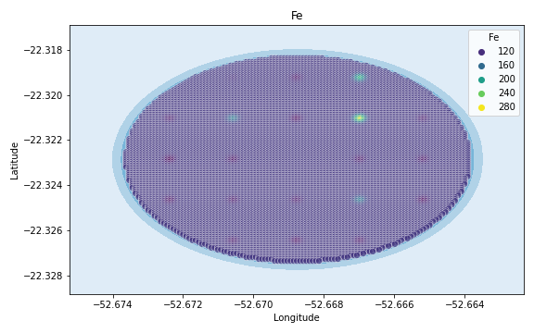
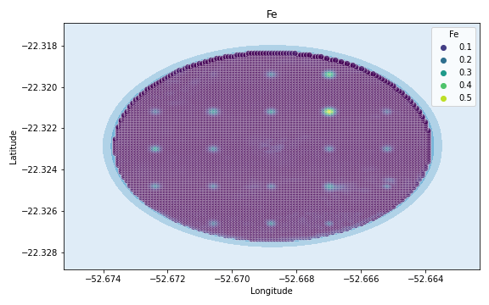
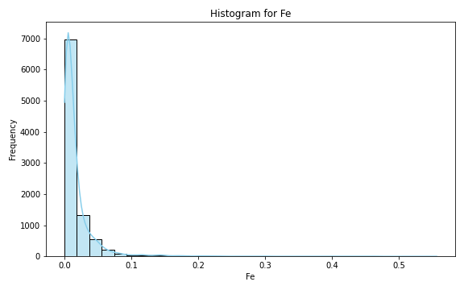
Analysis for column: Fe Model: Random Forest
Statistics:
mean 4.725327e+02
std 2.089397e+03
min 7.006193e-10
25% 7.240767e-03
50% 1.490089e-02
75% 5.550230e-01
80% 1.110209e+00
85% 4.051565e+00
90% 1.619851e+01
95% 5.517812e+02
99% 7.589556e+03

Slide 10
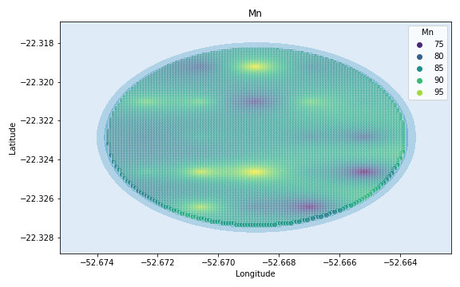
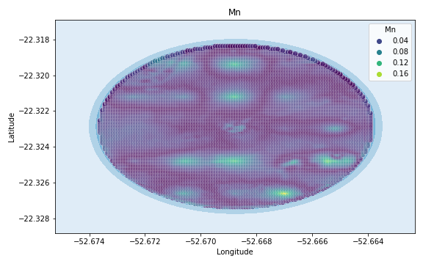
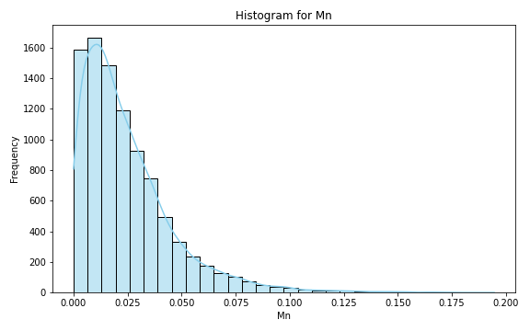
Analysis for column: Mn Model: Random Forest
Statistics:
mean 467.981392
std 2090.375434
min 0.000002
25% 0.023086
50% 0.038121
75% 0.193859
80% 0.345023
85% 1.126349
90% 2.583871
95% 473.806371
99% 7573.961274

Slide 11
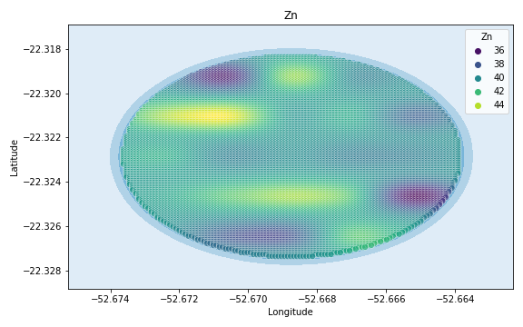
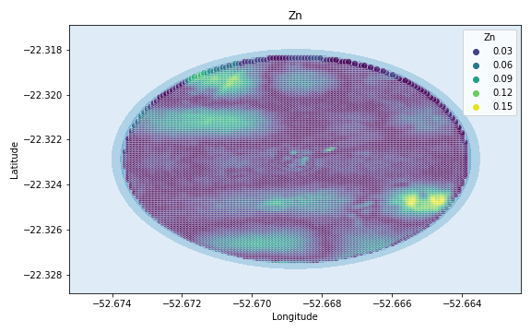
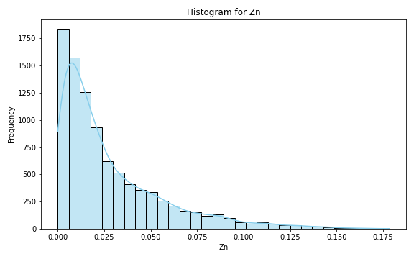
Analysis for column: Zn Model: Random Forest
Statistics:
mean 467.798379
std 2090.418114
min 0.000002
25% 0.026925
50% 0.047764
75% 0.186796
80% 0.342760
85% 1.071813
90% 1.840956
95% 470.678176
99% 7573.335635

Slide 12
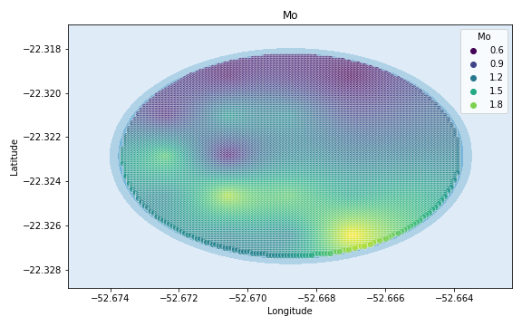
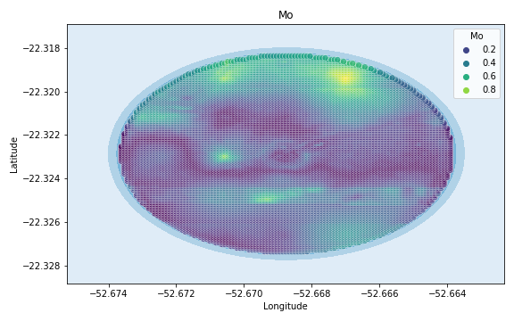
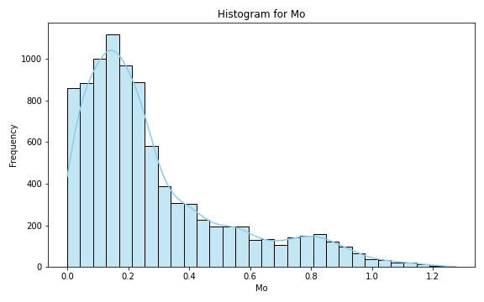
Analysis for column: Mo Model: Random Forest
Statistics:
mean 468.132029
std 2090.339599
min 0.000005
25% 0.215278
50% 0.367734
75% 1.060669
80% 1.322565
85% 1.393491
90% 1.991629
95% 471.019921
99% 7573.403984

Slide 13
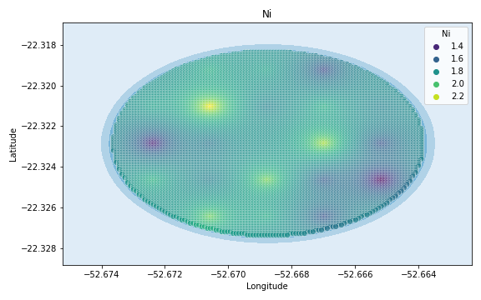
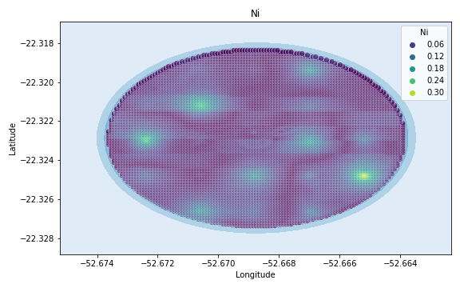
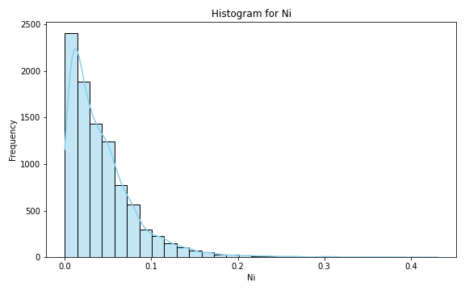
Analysis for column: Ni Model: Random Forest
Statistics:
mean 468.002645
std 2090.370411
min 0.000018
25% 0.036713
50% 0.062964
75% 0.312744
80% 0.444542
85% 1.139629
90% 2.542375
95% 473.721647
99% 7573.944329

Slide 14
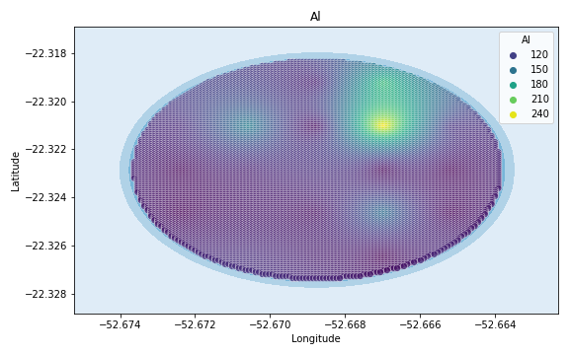
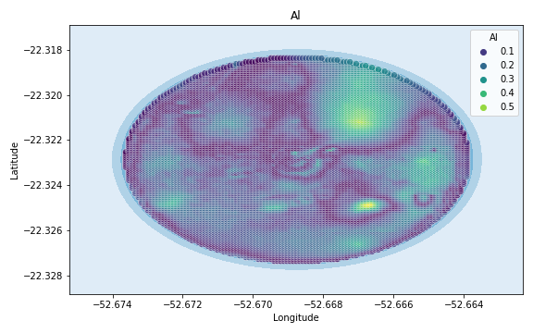
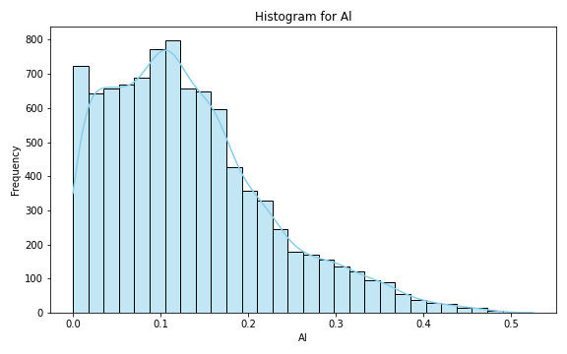
Analysis for column: Al Model: Random Forest
Statistics:
mean 468.193953
std 2090.325455
min 0.000003
25% 0.117239
50% 0.204629
75% 1.006505
80% 1.065746
85% 1.226662
90% 2.643926
95% 474.283066
99% 7574.056613

Slide 15
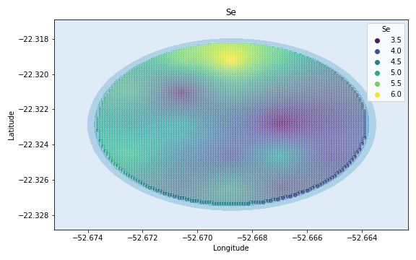
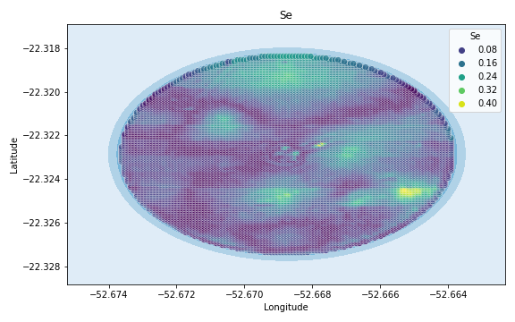
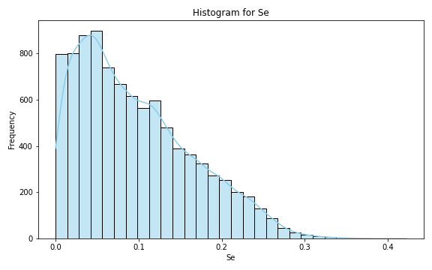
Analysis for column: Se Model: Random Forest
Statistics:
mean 467.728569
std 2090.434414
min 0.000004
25% 0.080273
50% 0.144498
75% 0.427638
80% 0.507882
85% 0.875294
90% 1.143216
95% 468.576381
99% 7572.915276

Slide 16
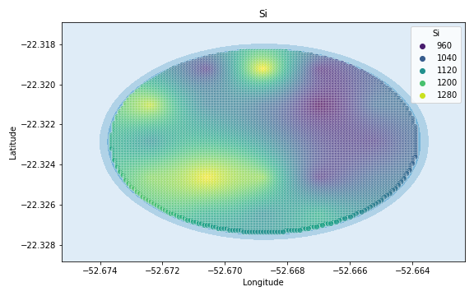
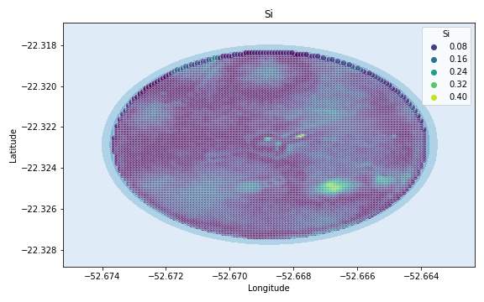
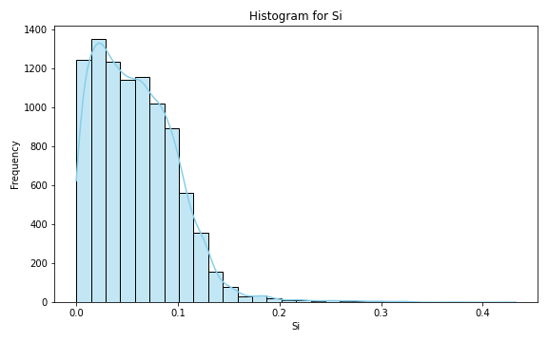
Analysis for column: Si Model: Random Forest
Statistics:
mean 467.653431
std 2090.452091
min 0.000002
25% 0.047213
50% 0.084258
75% 0.255405
80% 0.364706
85% 0.803292
90% 0.833446
95% 468.432191
99% 7572.886438

Slide 17
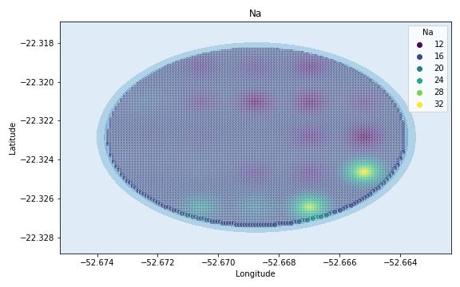
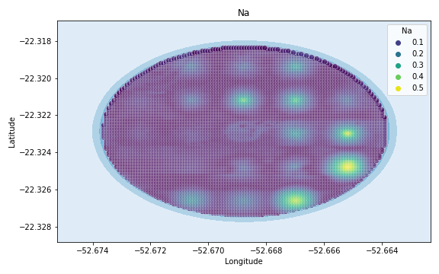

Analysis for column: Na Model: Random Forest
Statistics:
mean 4.682166e+02
std 2.090320e+03
min 6.404171e-16
25% 5.524980e-02
50% 9.622860e-02
75% 6.370969e-01
80% 7.703802e-01
85% 1.499616e+00
90% 3.236407e+00
95% 4.758730e+02
99% 7.574375e+03

Slide 18



Analysis for column: Va Model: Random Forest
Statistics:
mean 468.623203
std 2090.225578
min 0.000001
25% 0.149992
50% 0.247291
75% 1.335562
80% 2.136529
85% 2.213113
90% 3.611183
95% 479.123705
99% 7575.024741

Slide 19



Analysis for column: DRIS_N Model: Random Forest
Statistics:
mean 868.177944
std 2355.158607
min 0.000041
25% 0.435603
50% 0.874799
75% 32.119837
80% 296.453165
85% 1204.621086
90% 1633.266160
95% 5683.967930
99% 8615.993586

Slide 20



Analysis for column: DRIS_P Model: Random Forest
Statistics:
mean 503.045138
std 2087.729709
min 0.000013
25% 0.048778
50% 0.077995
75% 1.761376
80% 3.146344
85% 5.270441
90% 84.180724
95% 1119.192589
99% 7703.038518

Slide 21



Analysis for column: DRIS_K Model: Random Forest
Statistics:
mean 6113.480499
std 15799.513565
min 0.000007
25% 1.258022
50% 11.696420
75% 205.116796
80% 2219.219722
85% 8999.596160
90% 13572.958005
95% 51588.580047
99% 51588.580052

Slide 22



Analysis for column: DRIS_Ca Model: Random Forest
Statistics:
mean 469.631158
std 2089.995915
min 0.000033
25% 0.169983
50% 0.284310
75% 1.647101
80% 3.436269
85% 3.626487
90% 6.096960
95% 494.364409
99% 7578.072882

Slide 23



Analysis for column: DRIS_Mg Model: Random Forest
Statistics:
mean 726.648293
std 2262.086589
min 0.000008
25% 0.366879
50% 0.592888
75% 22.167134
80% 110.486945
85% 303.816832
90% 722.786408
95% 4736.286905
99% 8426.457381

Slide 24



Analysis for column: DRIS_S Model: Random Forest
Statistics:
mean 9.269558e+02
std 2.808699e+03
min 5.025996e-07
25% 9.753378e-02
50% 1.885109e-01
75% 2.646086e+01
80% 8.053540e+01
85% 8.246758e+01
90% 9.765232e+02
95% 8.945709e+03
99% 9.268342e+03

Slide 25



Analysis for column: DRIS_B Model: Random Forest
Statistics:
mean 475.832493
std 2088.771502
min 0.000012
25% 0.132369
50% 0.202822
75% 2.437721
80% 5.663997
85% 6.007952
90% 21.569993
95% 604.332788
99% 7600.066558

Slide 26



Analysis for column: DRIS_Cu Model: Random Forest
Statistics:
mean 4.715192e+02
std 2.089583e+03
min 4.828811e-07
25% 1.520577e-01
50% 2.485547e-01
75% 2.635854e+00
80% 5.116876e+00
85% 5.325409e+00
90% 1.175814e+01
95% 5.235167e+02
99% 7.583903e+03

Slide 27



Analysis for column: DRIS_Fe Model: Random Forest
Statistics:
mean 682.388616
std 2227.426248
min 0.000001
25% 0.263099
50% 0.483352
75% 16.701156
80% 63.909252
85% 106.780553
90% 497.982313
95% 4285.308235
99% 8336.261647

Slide 28



Analysis for column: DRIS_Mn Model: Random Forest
Statistics:
mean 8.924763e+02
std 2.729447e+03
min 3.115651e-12
25% 3.297324e-04
50% 2.862399e-03
75% 5.977327e+00
80% 1.051056e+01
85% 3.774556e+01
90% 9.174418e+02
95% 8.419426e+03
99% 9.163085e+03

Slide 29



Analysis for column: DRIS_Zn Model: Random Forest
Statistics:
mean 641.643146
std 2113.225226
min 0.000041
25% 0.649952
50% 1.303238
75% 19.014631
80% 149.727778
85% 584.365836
90% 749.403065
95% 2590.450917
99% 7997.290183

Slide 30



Analysis for column: IMS Model: Random Forest
Statistics:
mean 6.497611e+02
std 2.193530e+03
min 2.340087e-12
25% 4.632893e-03
50% 1.868777e-02
75% 1.968173e+01
80% 1.988242e+01
85% 2.545292e+01
90% 4.042405e+02
95% 3.820221e+03
99% 8.243244e+03

Slide 31



Analysis for column: IBN Model: Random Forest
Statistics:
mean 494.019708
std 2087.191190
min 0.000011
25% 0.066127
50% 0.115701
75% 3.255224
80% 6.370448
85% 7.966432
90% 65.099511
95% 940.457344
99% 7667.291469

